Slide 1
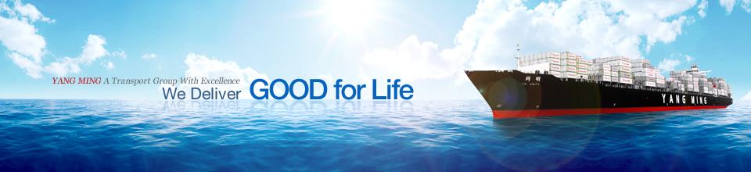
YANG MING
THE ALLIANCE
2018 NORTH AMERICA SERVICE MATRIX
Version update: 2018/4/16

Slide 2
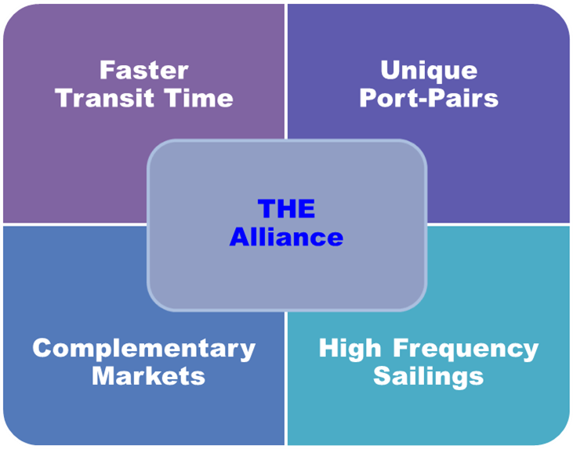
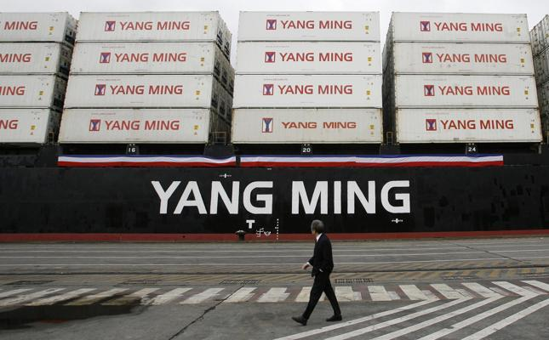
2018 Q2 North America Services
16 Service Loops with THE Alliance
  5 EC loops
  8 PSW loops
  3 PNW loops

Slide 3

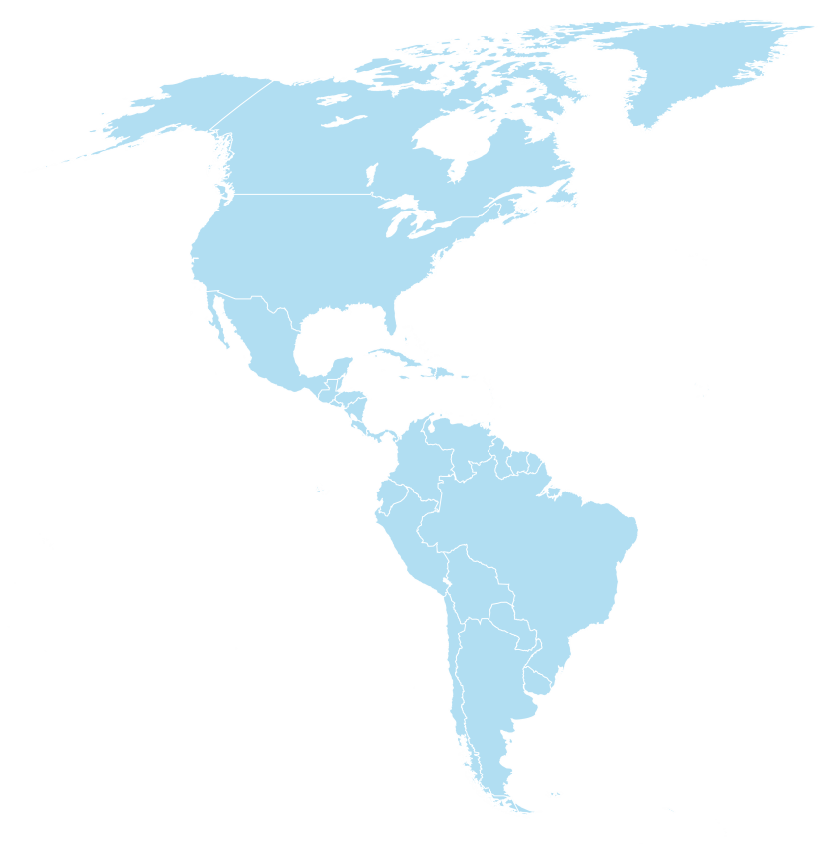
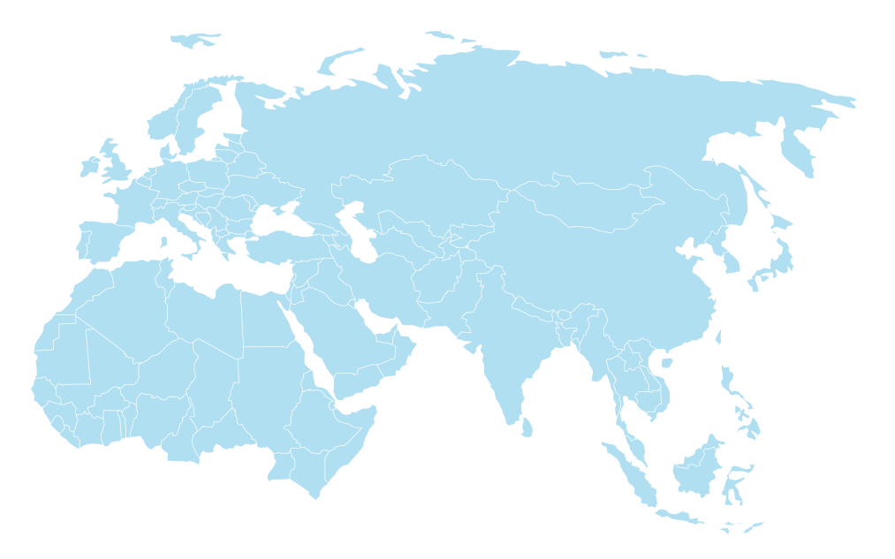
Asia – North America East Coast
5 EC loops
Express connection to New York, Savannah and Norfolk main markets
Expanded coverage to Halifax , Boston, Wilmington, Jacksonville
Extensive coverage of Southeast Asia

Slide 4
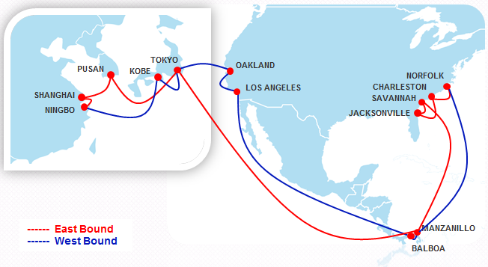
East Coast Loop 1 : EC1
Service Highlights
Express service from Central China, KR and JP to Savannah and Jacksonville
Direct calling service from JP to EC
Premium service for US reefer to JP
Extensive coverage of Balboa port for Latin America

Slide 5
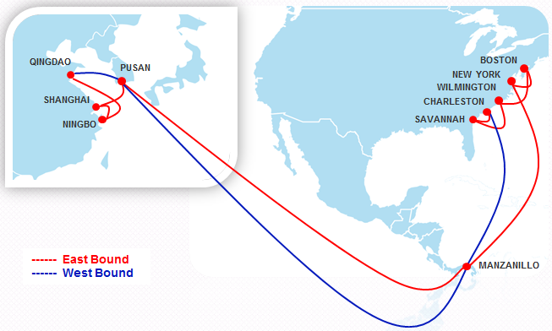
East Coast Loop 2 : EC2
Service Highlights
Express service from Central China and KR to New York
Extensive coverage of Boston/ Wilmington
Fast transit time between Savannah and Pusan, China
Far-reaching service to Bohai bay via feeder connection

Slide 6
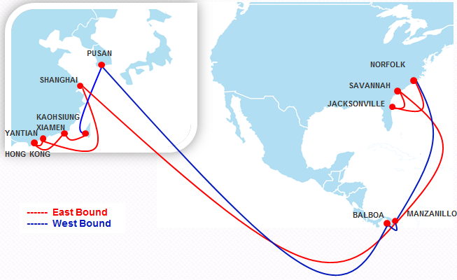
East Coast Loop 3 : EC3
Service Highlights
Express service from TW/ South China and SHA to Savannah and Norfolk
Extensive coverage of Balboa port for Latin America
Fast t/s time from USEC to KR
Jointly with EC1 for Japan market via fast feeder connection to Japan side ports via Pusan

Slide 7
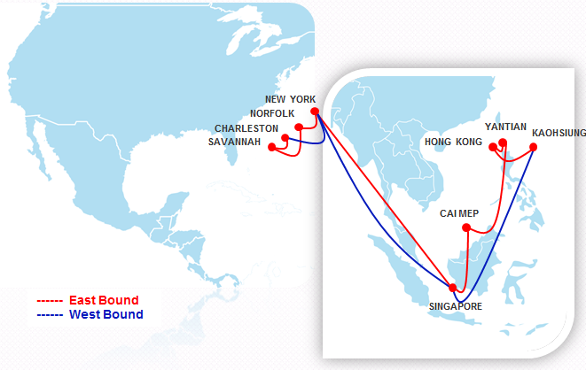
East Coast Loop 4 : EC4
Service Highlights
Express service between TW, South China, VN and New York
Extensive coverage of South East Asia ports via SE Asia Hub
Fast and direct service between key Atlantic ports and South East Asia, Taiwan and South China

Slide 8
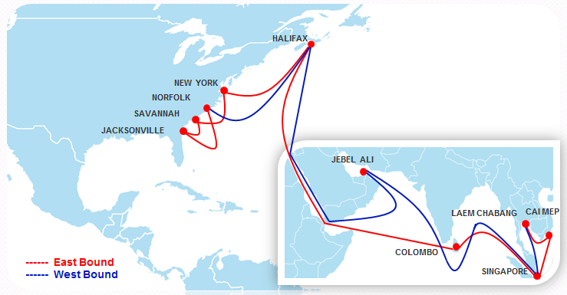
East Coast Loop 5 : EC5
Service Highlights
Halifax double call offers competitive transit time both import and export
Direct connection between Thailand/Vietnam and Halifax
Fast service to Middle East market via Jebel Ali

Slide 9
Asia – North America West Coast
(PSW)
8 PSW loops
Express connection to PSW ports
from main loading ports Taiwan, China, Korea and Japan
Express IPI gateway to US Gulf and Mid-West
Extensive coverage of Southeast Asia/ Bohai Bay

Slide 10
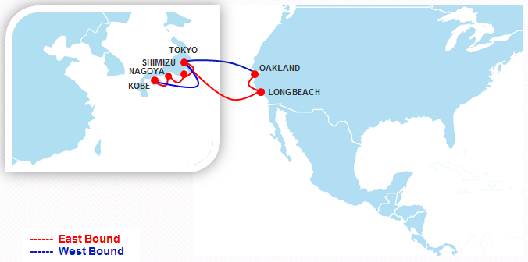
Pacific South Loop 2 : PS2
Service Highlights
Express service between JP and PSW
Extensive coverage of Shimizu port
Premium service for US reefer to JP

Slide 11
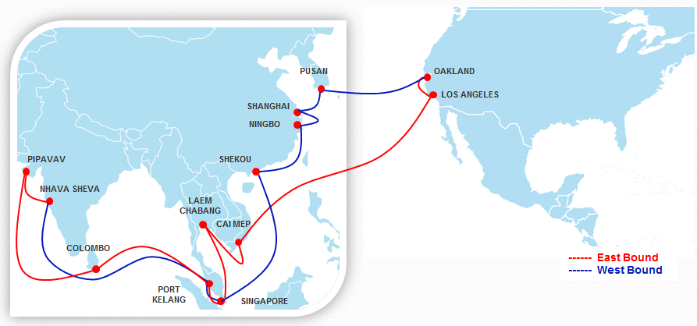
Pacific South Loop 3 : PS3
Service Highlights
Direct service between Thailand, Vietnam and PSW
Premium service for US reefer to Pusan
Extensive coverage for South East Asia and Indian Subcontinent markets

Slide 12
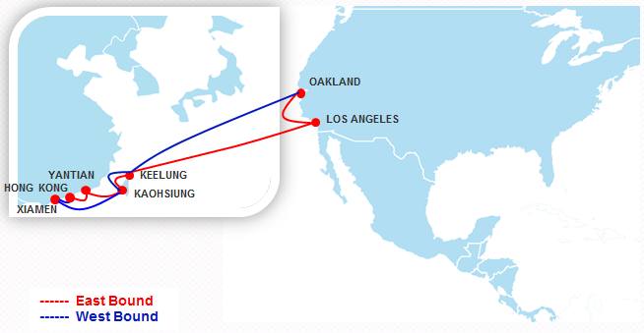
Pacific South Loop 4 : PS4
Service Highlights
Direct service between South China/TW and PSW
Extensive coverage of Xiamen and Keelung port
Premium service for US reefer to TW
Extensive service for Australia, China Pearl River Delta and Philippines market via Kaohsiung/Hong Kong transit

Slide 13
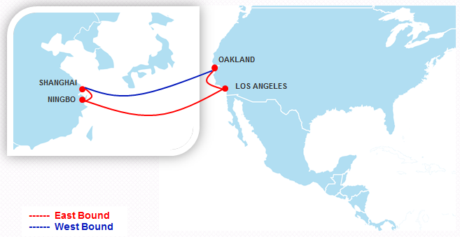
Pacific South Loop 5 : PS5
Service Highlights
Express shuttle service between Shanghai/Ningbo and PSW
Dedicated and fast service for China Yangtze River market

Slide 14
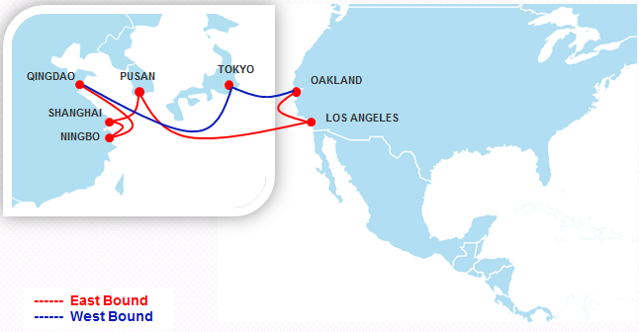
Pacific South Loop 6 : PS6
Service Highlights
Direct service between Central China/KR and PSW
Fast t/s time between PSW and Qingdao
Jointly with PS2 for Japan market via fast Pusan feeder connection for Japan side ports
Extensive coverage for China Yangtze River market

Slide 15
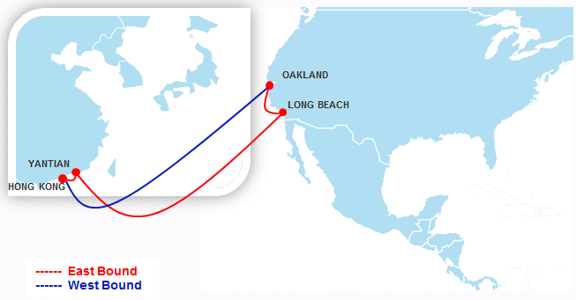
Pacific South Loop 7 : PS7
Service Highlights
Express service between South China and PSW
Dedicated and fast service for China Yangtze River market

Slide 16
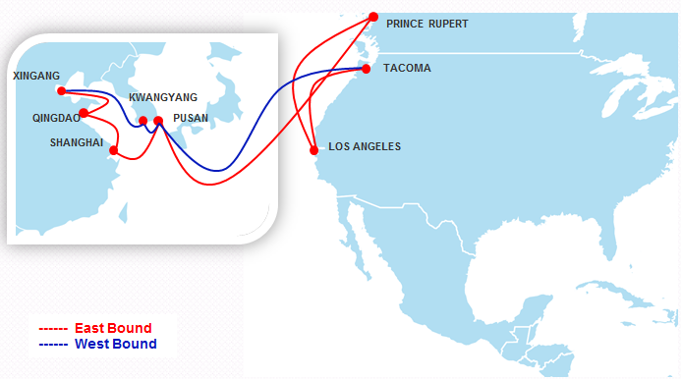
Pacific South Loop 8 : PS8
Service Highlights
Express IPI/East Canada service via Prince Rupert
Direct service from Bohai Bay ports and Pusan to PSW
Premium service for US reefer to KR and North China

Slide 17
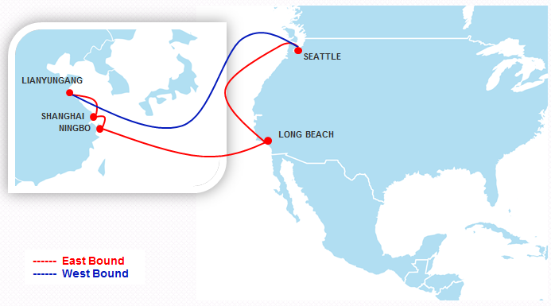
AAC
Service Highlights
Direct connection from Lianyungang to both PSW and PNW
Fast transit time from Long Beach/Seattle to Lianyungang

Slide 18


Asia – North America West Coast (PNW)
3 PNW loops
Express connection to PNW ports
from main loading ports Taiwan, China, Korea and Japan
Express IPI gateway to US and Canada via Vancouver
Extensive coverage of Southeast Asia

Slide 19
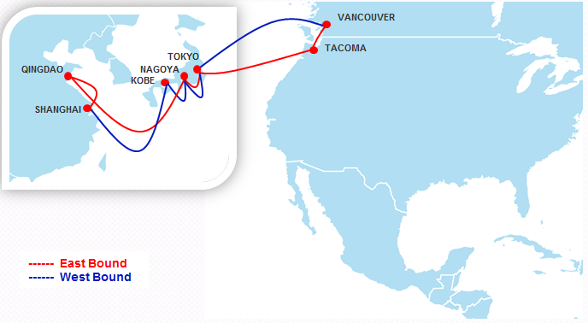
Pacific Northwest Loop 1 : PN1
Service Highlights
Express service between Japan and PNW
Direct connection between Qingdao/Shanghai and PNW
Reefer service from Tacoma/Vancouver to Japan base ports

Slide 20
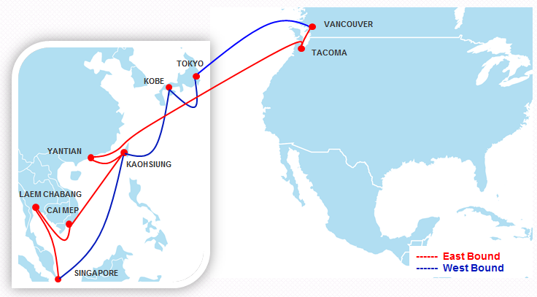
Pacific Northwest Loop 2 : PN2
Service Highlights
Direct service between Thailand, Vietnam, SE Asia hub and PNW
Fast transit time from S. China/Kaohsiung to Vancouver
Non-FROB vessel for Canada export to Japan, Taiwan, South China and Southeastern Asia market
Reefer service to Japan and Taiwan

Slide 21
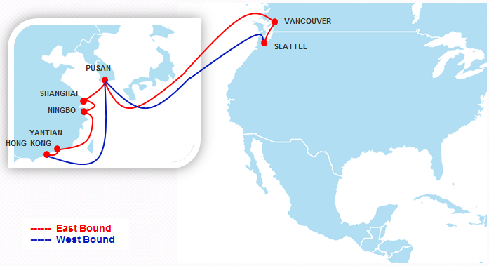
Pacific Northwest Loop 3 : PN3
Service Highlights
Vancouver first call offers fast transit time for Canadian import cargo
Direct connection between China base ports/Korea and PNW
Fast transit time from Vancouver/PNW to Korea/Hong Kong/South China

Slide 22
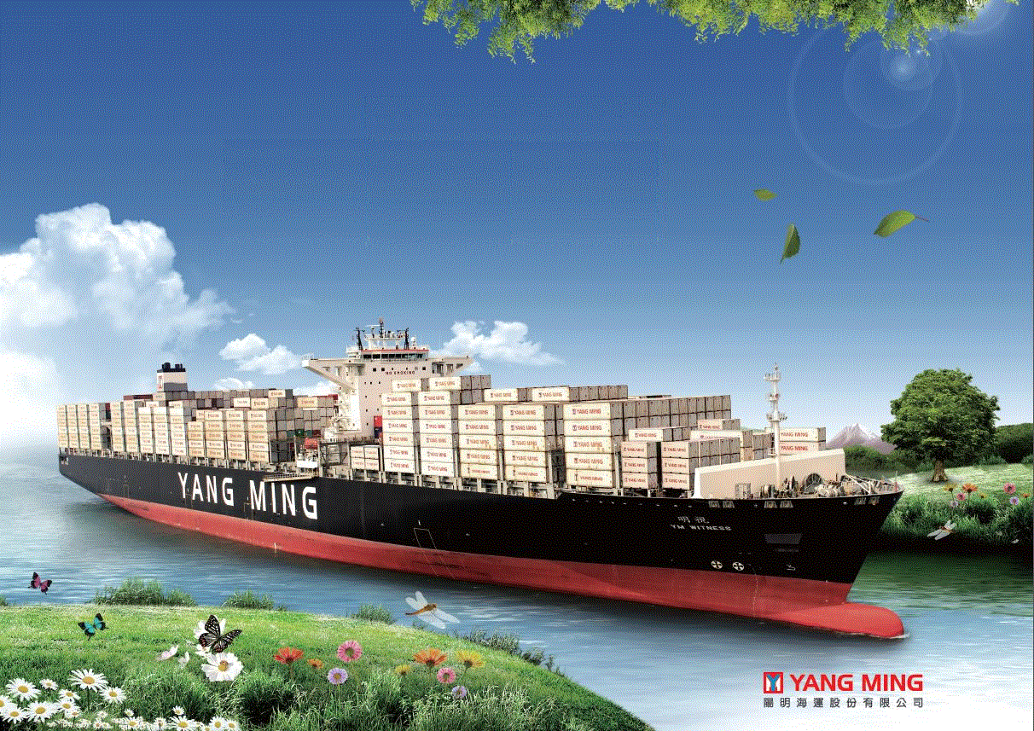
Thank you!
Please contact with your local sales for further information.

