Slide 1
YANG MING
THE ALLIANCE
2019 MIDDLE EAST SERVICE MATRIX
Version update: 2017/3/6

Slide 2
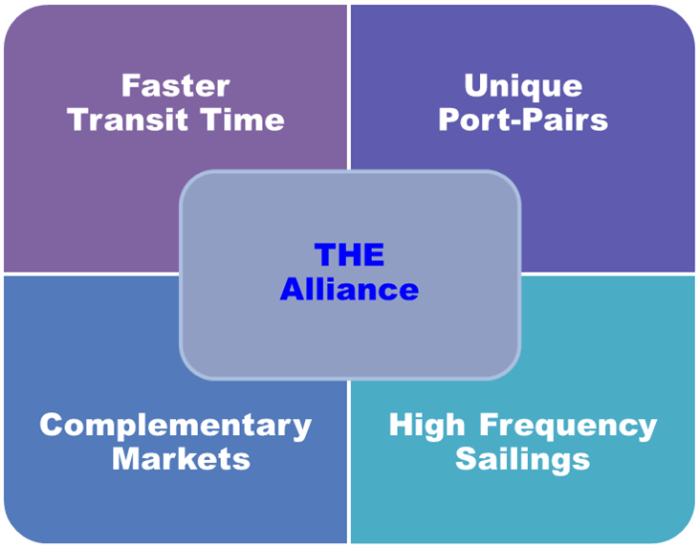
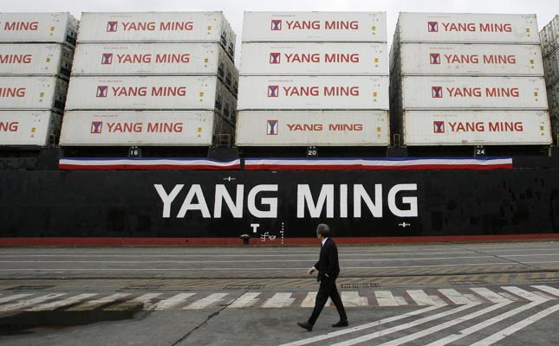
2019 Middle East Services
Service Loops with THE Alliance
CGX(AG2)

Slide 3
Asia – Middle East
Express connection to Jebel Ali, Hamad, Umm Qasr market
Direct connection between China, Taiwan and Middle East
Extensive coverage of Southeast Asia

Slide 4
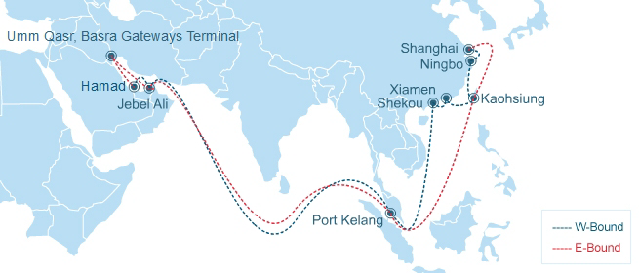
Middle East Loop
W-Bound | To | AEJEA | QAHMD | IQUQR
From | ETB/ETD | WED/THU | THU/FRI | SAT/MON
CNSHG | THU/FRI | 19 | 20 | 23
CNNBO | SAT/SAT | 18 | 19 | 22
TWKHH | MON/TUE | 16 | 17 | 20
CNXMN | WED/WED | 15 | 16 | 19
CNSHK | THU/FRI | 14 | 15 | 18
MYPKG | TUE/WED | 9 | 10 | 13
Service Highlights
Direct & Express service from Central, Southern China, Malaysia to Jebel Ali, Hamad & Umm Qasr
Unique call port of Xiamen
E-Bound | To | MYPKG | TWKHH | CNSHG | CNNBO | CNXMN | CNSHK
From | ETB/ETD | TUE/WED | MON/TUE | THU/FRI | SAT/SAT | WED/WED | THU/FRI
QAHMD | THU/FRI | 12 | 19 | 22 | 24 | 26 | 28
IQUQR | SAT/MON | 14 | 21 | 24 | 26 | 28 | 30
AEJEA | TUE/WED | 11 | 18 | 21 | 23 | 25 | 27

Slide 5
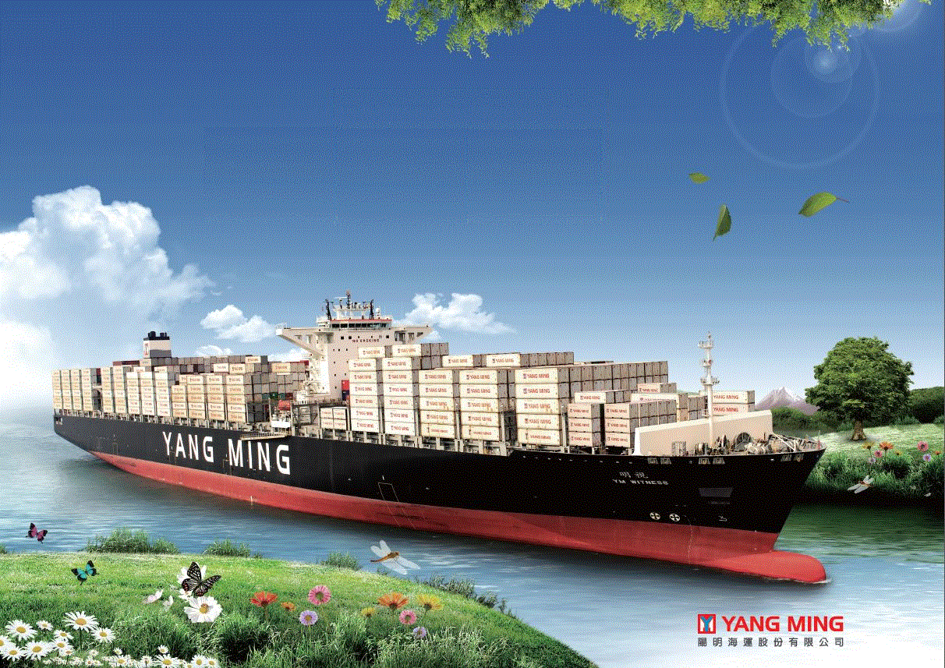
Thank you!
Please contact with your local sales for further information.

