Slide 1
YANG MING
THE ALLIANCE
2018 EUROPE SERVICE
Version update: 2018.03.09

Slide 2
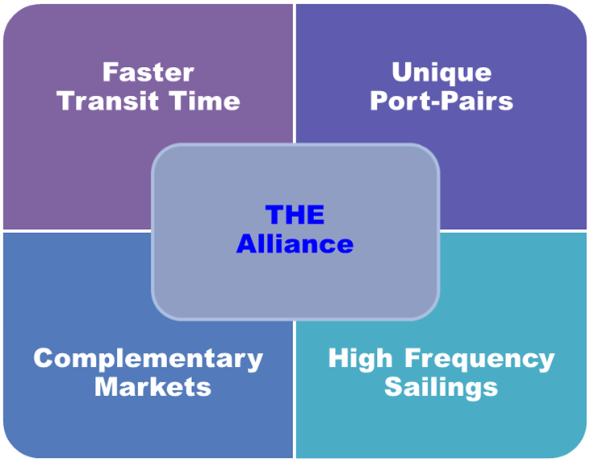
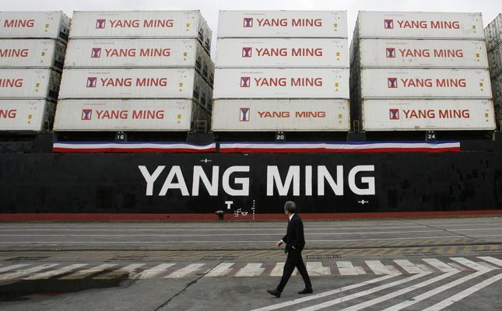
2018 Europe Service
15 Loops with THE Alliance
5 NCP Loops
3 MED Loops
7 TA Loops

Slide 3
Asia – North Europe
5 Loops
Direct Connection Between Japan And North Europe
Direct Connection Between Southeast Asia and North Europe
Express Service to UK

Slide 4
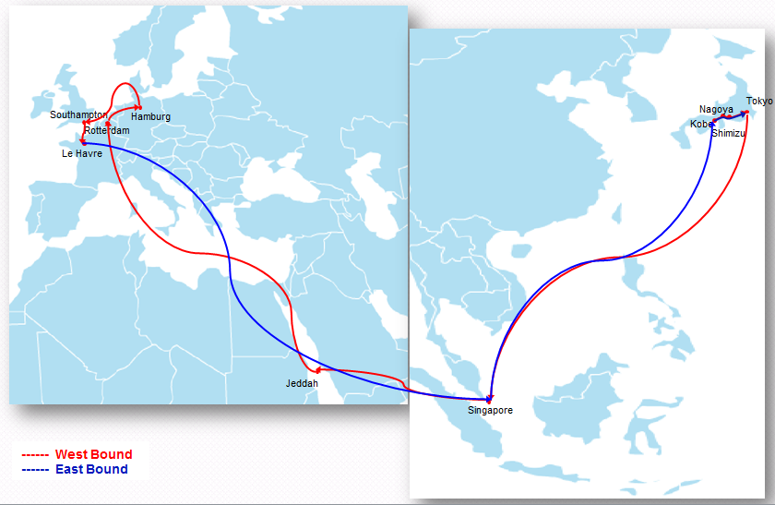
Fareast Europe Loop 1 : FE1
Service Highlights
Direct & Express service from and to Japan
Unique call port of Shimizu.
Very fast service from Singapore to Rotterdam
Direct service from Jeddah to North Europe

Slide 5
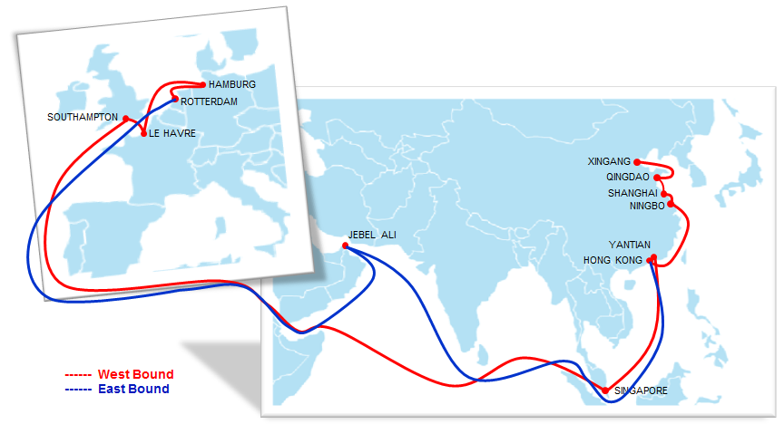
Fareast Europe Loop 2 : FE2
Service Highlights
Direct & Express service from and to North China.
Express service to UK and France
Direct Service From Europe to Persian Gulf

Slide 6
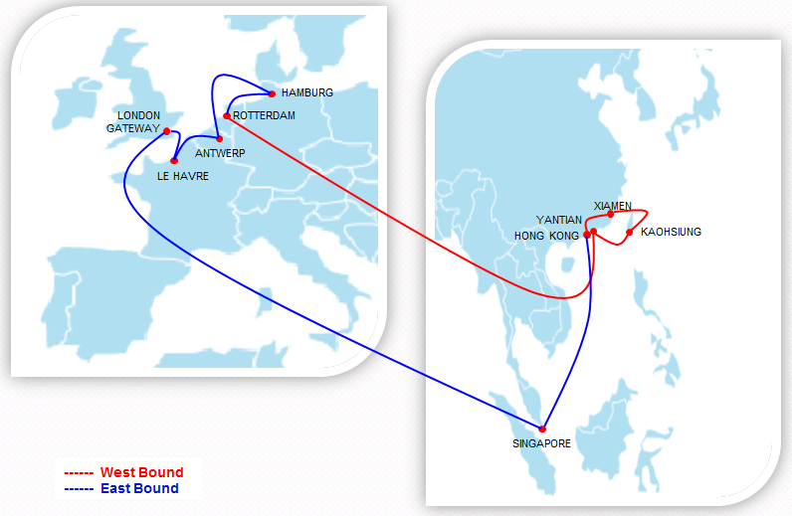
Fareast Europe Loop 3 : FE3
Service Highlights
Direct & Express service from and to Taiwan & South China
Direct service from Xiamen and Kaohsiung to North Europe

Slide 7
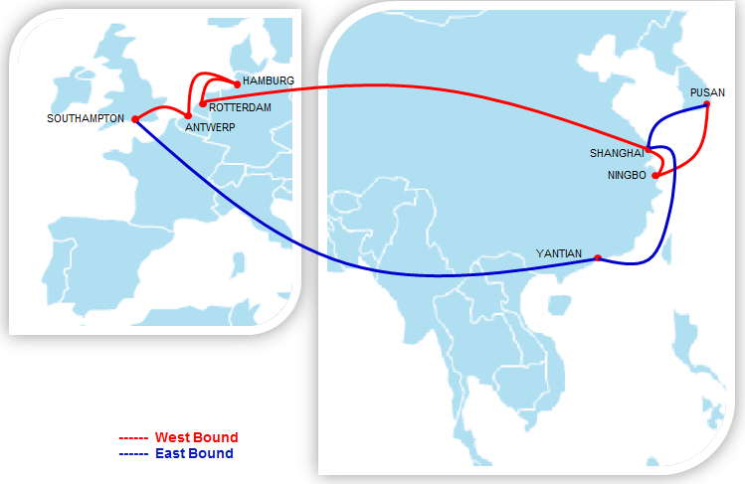
Fareast Europe Loop 4 : FE4
Service Highlights
Direct & Express service from and to Pusan and East China
Very fast service from Pusan to Rotterdam

Slide 8
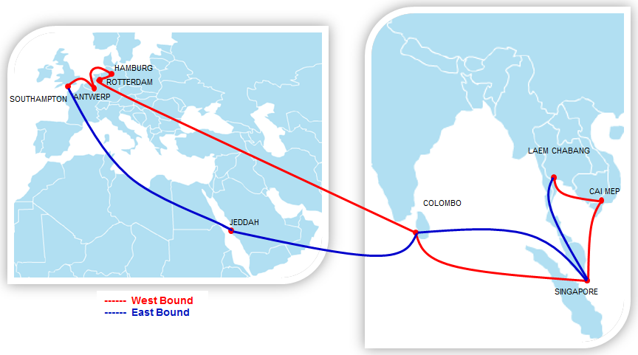
Fareast Europe Loop 5 : FE5
Service Highlights
Direct & Express service from and to Southeast Asia.
Direct service from North Europe to Jeddah on back haul.

Slide 9
Asia – Mediterranean
3 Loops
Direct Connection Between Asia and Turkey
Direct Service To Ashdod, Israel & Tangier, Morocco
Express Service To Spain, Italy and South France

Slide 10
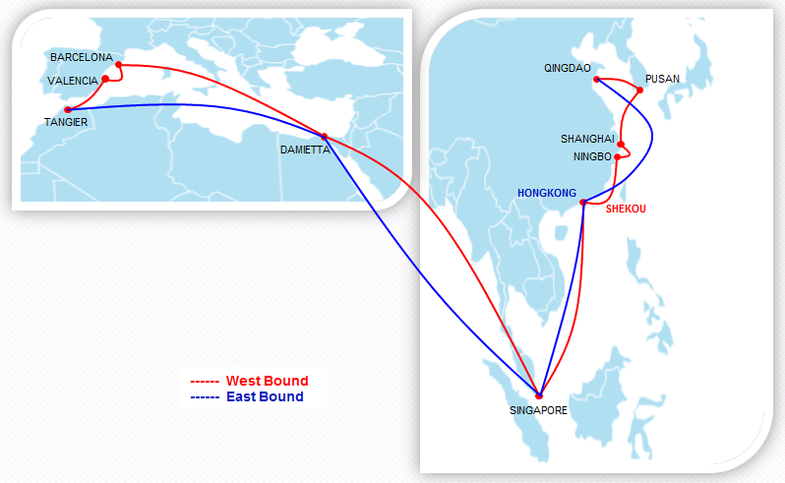
Mediterranean Loop 1 : MD1
Service Highlights
Direct service from and to Qingdao & Pusan;
Express service to Spain,
Direct service to Tangier,
Wide-spread East Med feeder via East Med Hub.

Slide 11
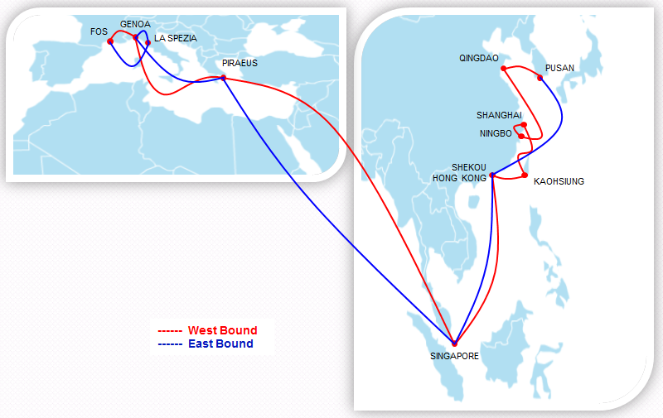
Mediterranean Loop 2 : MD2
Service Highlights
Direct & Express service from Pusan and Kaohsiung;
Express service into Italy and South France;
Wide-spread East Med feeder via East Med Hub.

Slide 12
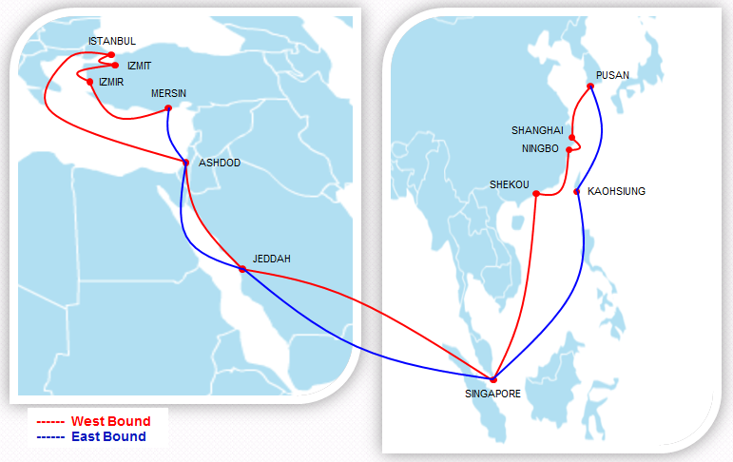
Mediterranean Loop 3 : MD3
Service Highlights
Direct service link Pusan, East and South China to East MED main markets;
Direct service to serve Ashdod and Turkish ports;
Full coverage of Turkish gate ports, and express feeder into and out of Black Sea markets;
Jeddah and Kaohsiung added on back haul.

Slide 13
Europe - America
7 Loops
Direct Service to Gulf of Mexico
Direct Service to Mexico
Direct Service to US West Coast

Slide 14
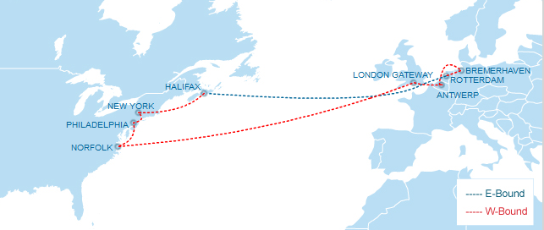
Atlantic Loop 1 : AL1
Service Highlights
Express service from Europe to Norfolk.
Express service from Europe to Philadelphia.

Slide 15
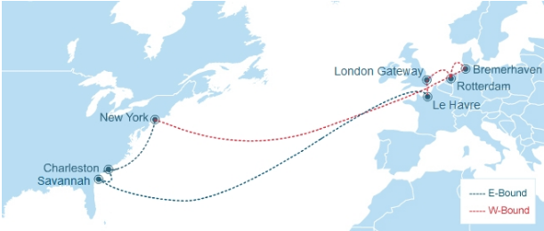
Atlantic Loop 2 : AL2
Service Highlights
Express service from Europe to New York.

Slide 16
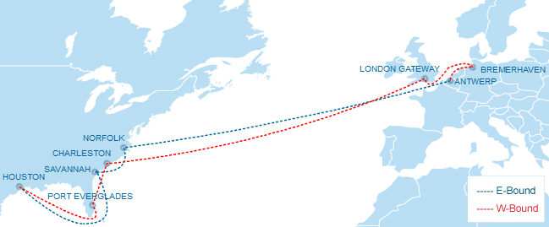
Atlantic Loop 3 : AL3
Service Highlights
Direct service from Europe to Port Everglades.
Direct service from Europe to Houston.

Slide 17
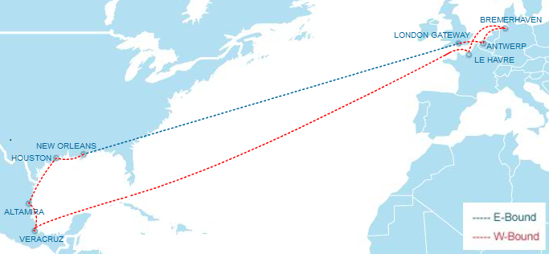
Atlantic Loop 4 : AL4
Service Highlights
Direct & Express service from Europe to Mexico.
Direct service from Europe to Houston, New Orleans.

Slide 18
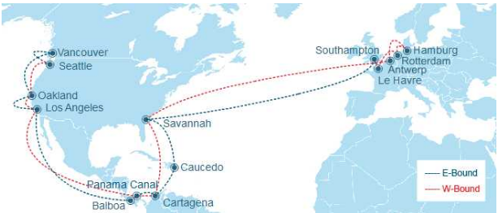
Atlantic Loop 5 : AL5
Service Highlights
Direct service between North Europe and US West Coast.
Service covering Pacific Southwest and Pacific Northwest.
Intra-American ports connections.

Slide 19
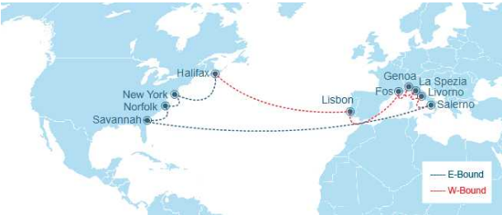
Atlantic Loop 6 : AL6
Service Highlights
Express service from Italy to New York
Unique call ports of Salerno, Livorno and La Spezia.

Slide 20
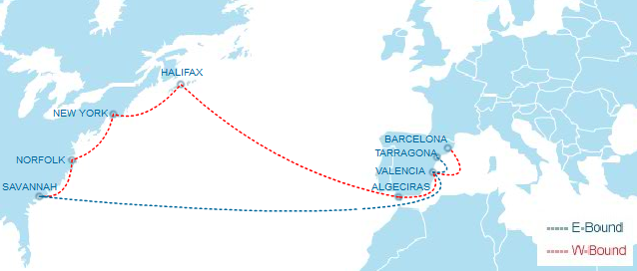
Atlantic Loop 7 : AL7
Service Highlights
Express service from Spain to Halifax and New York.
Unique call Algeciras.

Slide 21
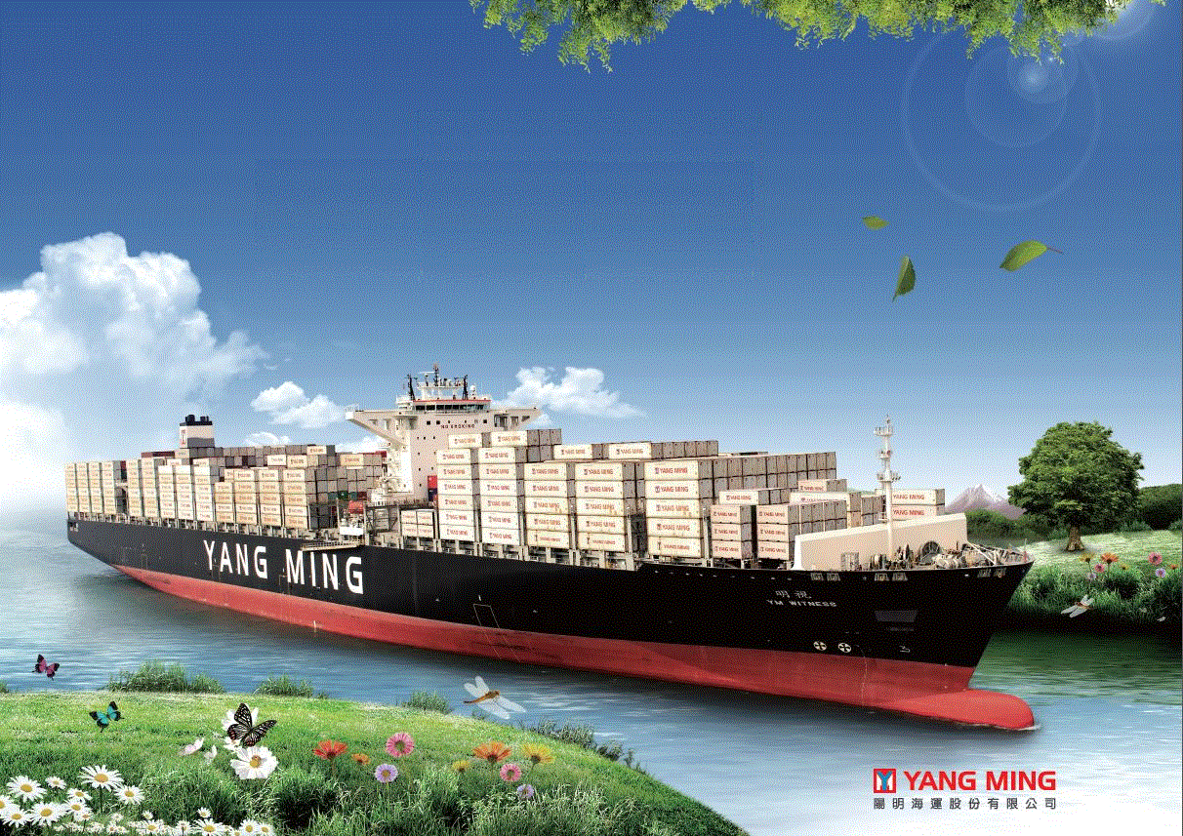
Thank you!
Please contact with your local sales for further information.

